Slide 1
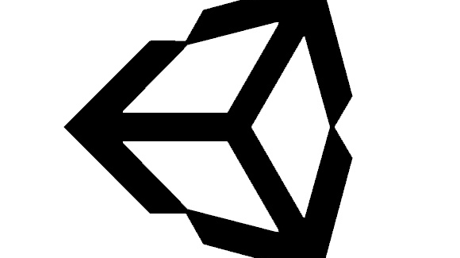
Intro to Unity – Import Models
By: Jeremy nIELSON

Slide 2
Assets and Packages
This tutorial will be a general overview on how to use the assets and packages that we have already imported into the project. This includes
Standard Asset imports
Game Objects
Physics
If you haven’t already, make sure to import the remaining standard assets
Some of what will be covered involves physics objects, but these will be utilized better once we cover navigation and interactions in later tutorials

Slide 3

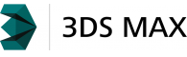
Custom Assets?
This tutorial will not be covering how to create your own custom assets. If you are looking for how to create 3D Models, there is a plethora of tutorials available online. Below are a few links to get started:
Software:
Blender: Free 3d Modeling Tool
3DSMax: Paid 3D Modeling Tool
Example Tutorials:
Character Modeling
Building Modeling

Slide 4
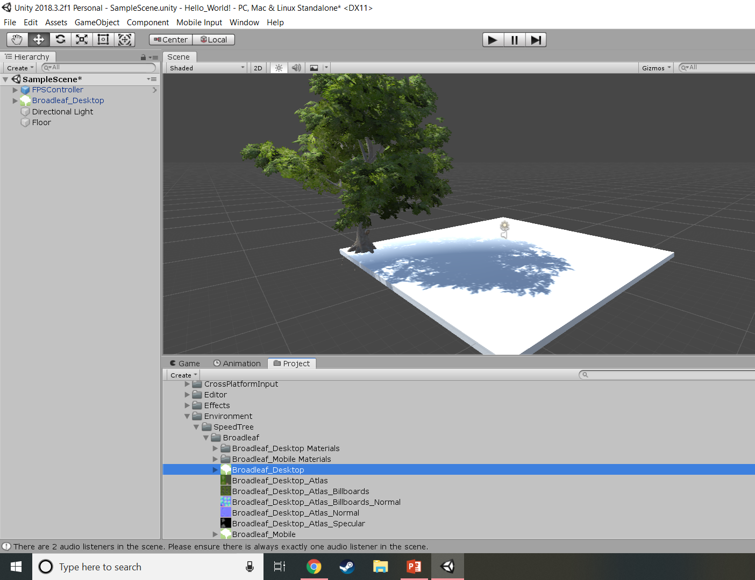
Place a tree
Select Broadleaf_Desktop like shown
Drag and drop onto the scene

Slide 5
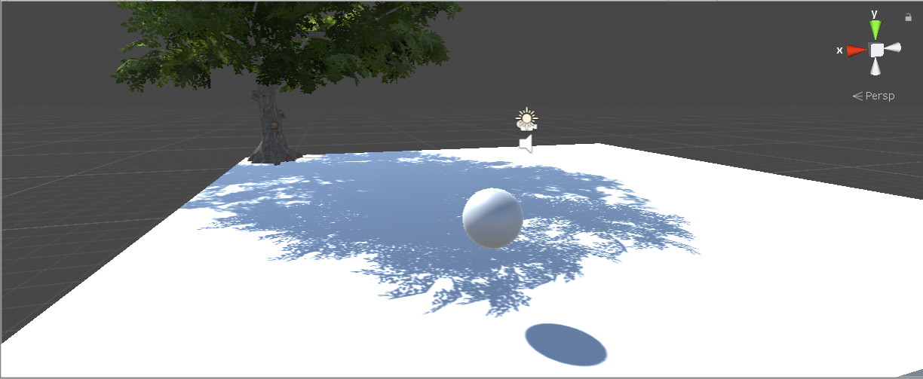
Create a Physics Object
GameObject > 3D > Sphere
Move it somewhere in the world
Under Inspector:
Scroll down to “Add Component”
Search “Rigidbody”
Add the component

